Slide 1
AI

Slide 2
Artificial Intelligence
8.3.1 Logical Agents (Ch. 7)

Slide 3
Outline
Knowledge-based agents
Wumpus world
Logic in general – models and entailment
Propositional (Boolean) logic
Equivalence, validity, satisfiability
Inference rules and theorem proving
forward chaining
backward chaining
resolution

Slide 4

Knowledge Bases
Knowledge base = set of sentences in a formal language
Declarative approach to building an agent (or other system):
Tell it what it needs to know
Then it can Ask itself what to do - answers should follow from the KB
Agents can be viewed at the knowledge level
i.e., what they know, regardless of how implemented
Or at the implementation level
i.e., data structures in KB and algorithms that manipulate them

Slide 5
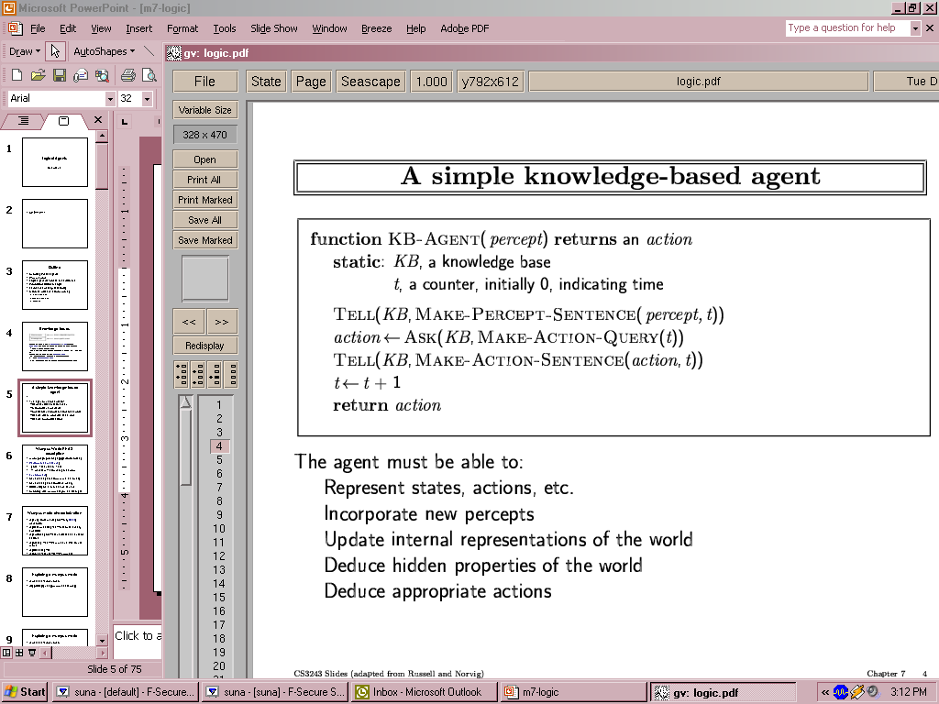
A simple knowledge-based agent
The agent must be able to:
Represent states, actions, etc.
Incorporate new percepts
Update internal representations of the world
Deduce hidden properties of the world
Deduce appropriate actions

Slide 6
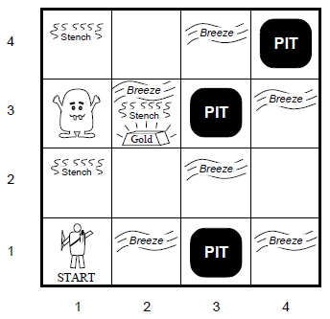
Wumpus World PEAS description
Performance measure
gold +1000, death -1000
-1 per step, -10 for using the arrow
Environment
Squares adjacent to wumpus are smelly
Squares adjacent to pit are breezy
Glitter iff gold is in the same square
Shooting kills wumpus if you are facing it
Shooting uses up the only arrow
Grabbing picks up gold if in same square
Releasing drops the gold in same square
Sensors: Stench, Breeze, Glitter, Bump, Scream
Actuators: Left turn, Right turn, Forward, Grab, Release, Shoot

Slide 7
Links
Minesweeper
http://minesweeperonline.com/
Battleships
http://www.battleshiponline.org

Slide 8
Wumpus world characterization
Fully Observable
No – only local perception
Deterministic
Yes – outcomes exactly specified
Episodic
No – sequential at the level of actions
Static
Yes – Wumpus and Pits do not move
Discrete
Yes
Single-agent?
Yes – Wumpus is essentially a natural feature

Slide 9
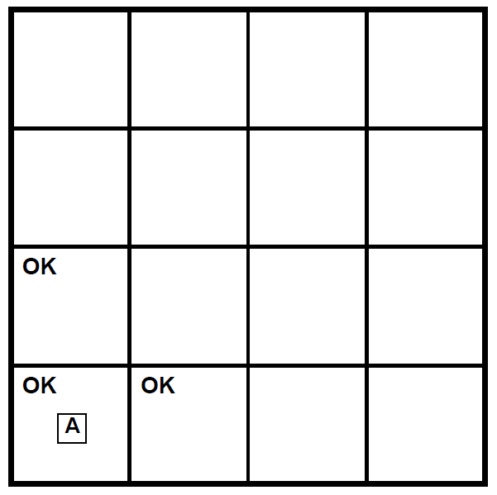
Exploring a wumpus world

Slide 10
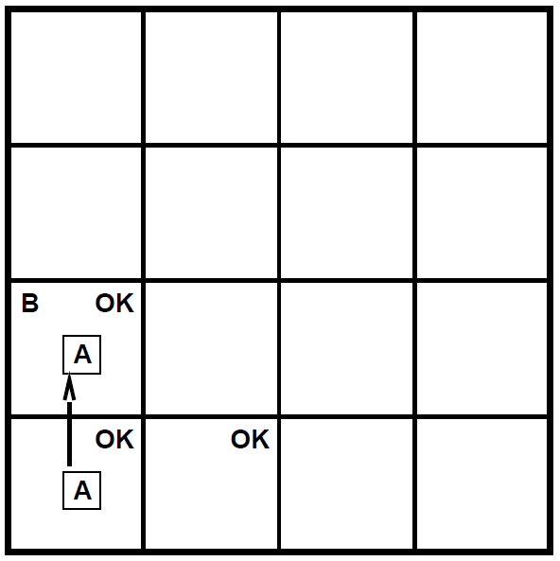
Exploring a wumpus world

Slide 11
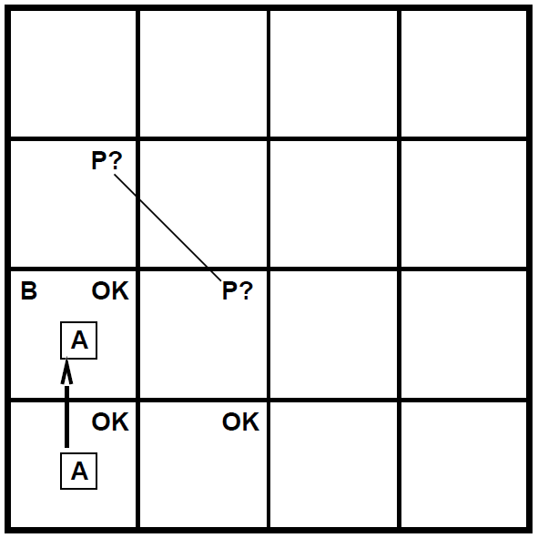
Exploring a wumpus world

Slide 12
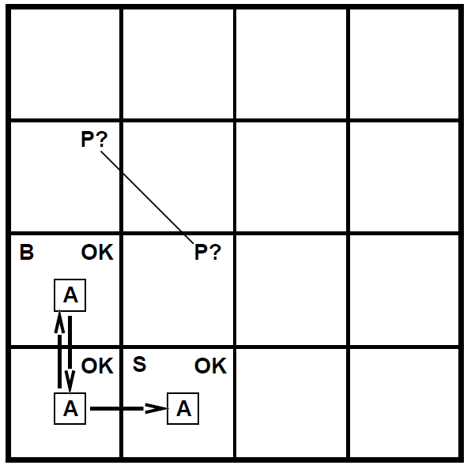
Exploring a wumpus world

Slide 13
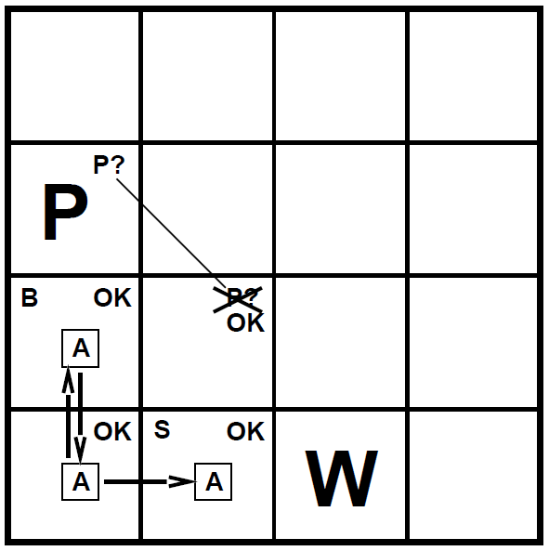
Exploring a wumpus world

Slide 14
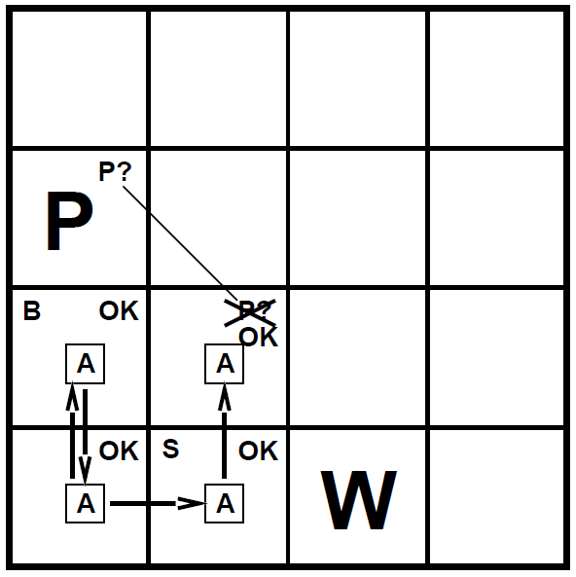
Exploring a wumpus world

Slide 15
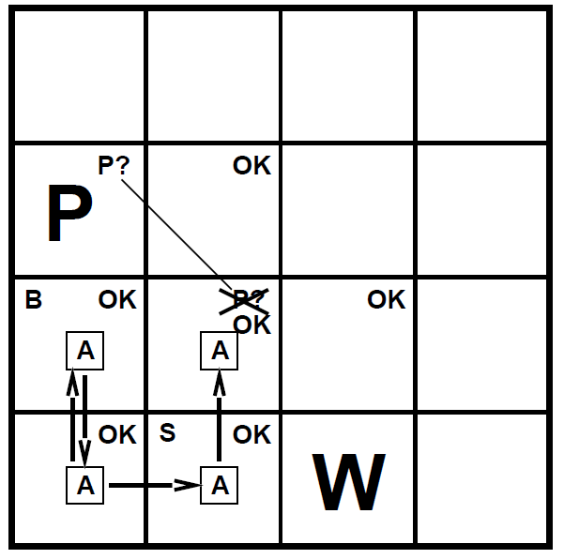
Exploring a wumpus world

Slide 16
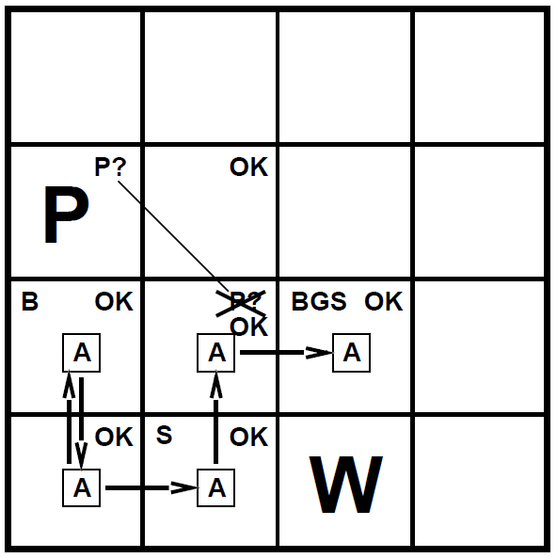
Exploring a wumpus world

Slide 17
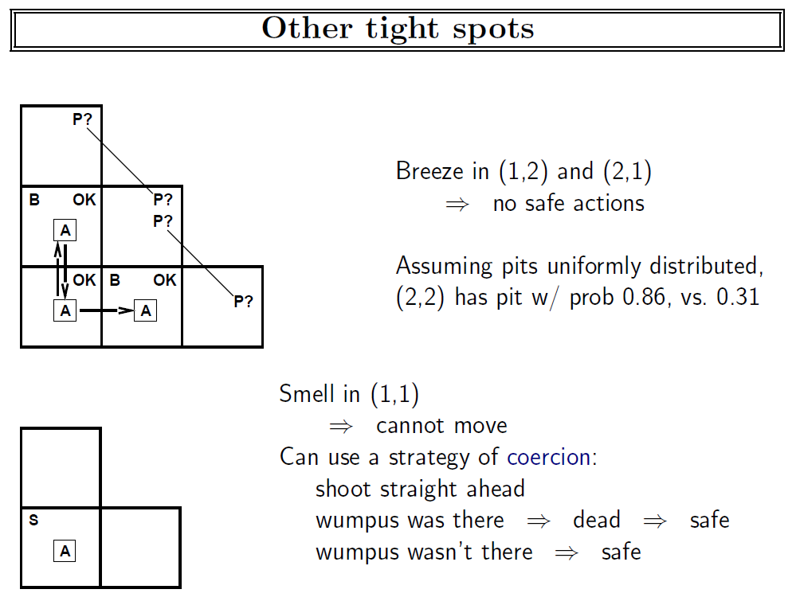

Slide 18
Logic in general
Logics are formal languages for representing information such that conclusions can be drawn
Syntax defines the sentences in the language
Semantics define the "meaning" of sentences;
i.e., define truth of a sentence in a world
E.g., the language of arithmetic
x+2 ≥ y is a sentence; x2+y > is not a sentence
x+2 ≥ y is true iff the number x+2 is no less than the number y
x+2 ≥ y is true in a world where x = 7, y = 1
x+2 ≥ y is false in a world where x = 0, y = 6

Slide 19
Entailment
Entailment means that one thing follows from another KB ╞ α
Knowledge base KB entails sentence α if and only if α is true in all worlds where KB is true
E.g., the KB containing “the Giants won” and “the Reds won” entails “Either the Giants won or the Reds won”
E.g., x+y = 4 entails 4 = x+y
Entailment is a relationship between sentences (i.e., syntax) that is based on semantics

Slide 20
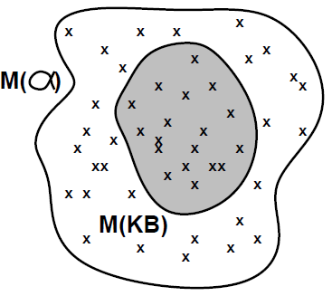
Models
Logicians typically think in terms of models, which are formally structured worlds with respect to which truth can be evaluated
We say m is a model of a sentence α if α is true in m
M(α) is the set of all models of α
Then KB ╞ α iff M(KB) ⊆ M(α)
E.g.
KB = Giants won and Reds won
α = Giants won

Slide 21
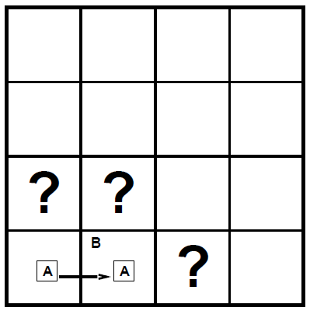
Entailment in the wumpus world
Situation after detecting nothing in [1,1], moving right, breeze in [2,1]
Consider possible models for KB assuming only pits
3 Boolean choices ⇒ 8 possible models

Slide 22
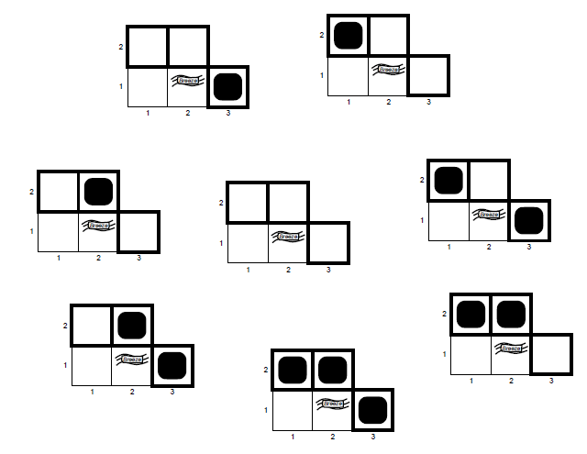
Wumpus models

Slide 23
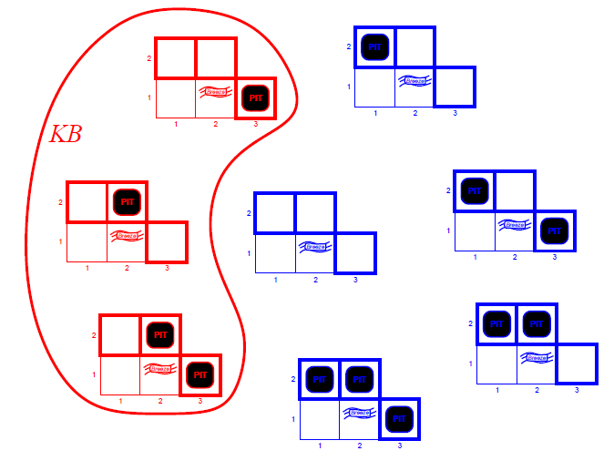
Wumpus models
KB = wumpus-world rules + observations

Slide 24
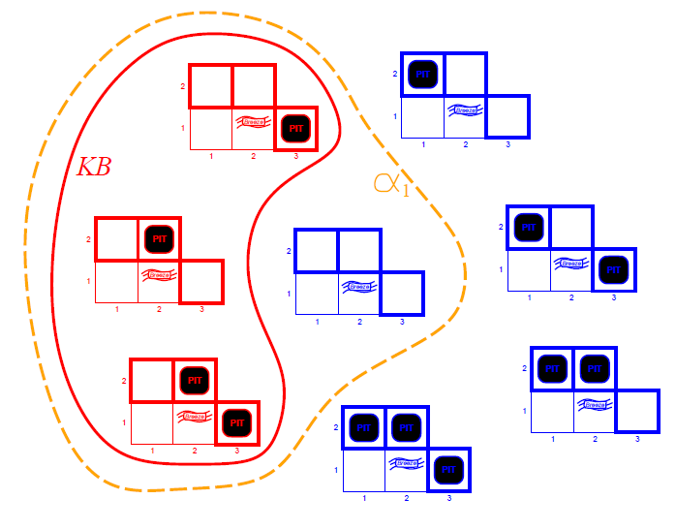
Wumpus models
KB = wumpus-world rules + observations
α₁ = "[1,2] is safe", KB ╞ α₁, proved by model checking

Slide 25
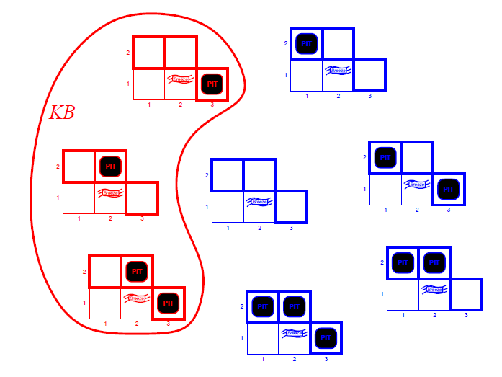
Wumpus models
KB = wumpus-world rules + observations

Slide 26
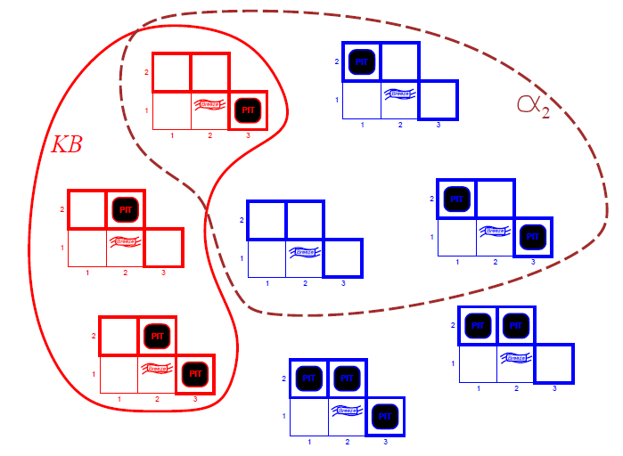
Wumpus models
KB = wumpus-world rules + observations
α₂ = "[2,2] is safe", KB ╞ α₂

Slide 27
Logic problem
There are two types of people on an island:
Knight: Always tells truth.
Knave: Always lies
A says: "B is a knight."
B says: "The two of us are opposite types."
Determine the types of A and B

Slide 28
Logical representation
We can describe the puzzle by the following propositions:
p: A is a knight, tells the truth.
^p: A is a knave, lies.
q: B is a knight, tells the truth.
^q: B is a knave, lies.

Slide 29
Reasoning for p
Suppose p=T:
A tells the truth: "B is a knight."
So B tells the truth.
B said: "The two of us are opposite types.".
So A and B are different types.
This is false, because both A and B are knights.

Slide 30
Reasoning for ^p
Suppose p=F:
A lies. So B is a knave.
So B lies.
B said: "The two of us are opposite types.".
So A and B are the same type.
This holds and we get the conclusion:
Both A and B are knaves.

Slide 31
Inference
KB ├_{i} α = sentence α can be derived from KB by procedure i
Soundness: i is sound if whenever KB ├_{i} α, it is also true that KB╞ α
Completeness: i is complete if whenever KB╞ α, it is also true that KB ├_{i} α
Preview: we will define a logic (first-order logic) which is expressive enough to say almost anything of interest, and for which there exists a sound and complete inference procedure.
That is, the procedure will answer any question whose answer follows from what is known by the KB.

Slide 32
Models
State-based
states, actions, costs
Used for route finding, game playing
Variable-based
variables, values, domains
used for scheduling, tracking, medical diagnosis
Logic-based
logical formulas and inference rules
used for theorem proving, verification, reasoning
[Example from Percy Liang]

Slide 33
Historical Notes
Logic was the dominant paradigm in AI until the 1990s
Problem 1
didn’t handle uncertainty (however, one can use probabilities)
Problem 2
didn’t address fine tuning from data (however, this can be solved using machine learning)
Strength
provides expressiveness in a compact way
[Example from Percy Liang]

Slide 34
AI

